Slide 1

EDA Presentation
Virtual Internship
16/06/2023
Presented by Initial Group

Slide 2


1.Introduction (Page 2)
2.EDA explanation (Page 3)
3.Data Understanding (Page 4)
4.Visualization and Statistical Analysis a) Numerical Columns b) Categorical Columns c) Comparation of Columns
5.Summary of findings
6.Recommendation
Page 1
Agenda

Slide 3
Introduction of Initial Group
Page 2
Introduction.
Thank you for trusting us and choosing us to help you with the struggle faced by XYZ company. We have run different type of analysis ( Visual and Statistic ) to help you improve the situation you are in.
We are Initial Group which contain 4 members:
Daria
Ahmet
Patrick
Salih
Before we dive deeper to what we done, we would like to introduce you to EDA – Exploratory Data Analysis so you can follow our presentation with better understanding.

Slide 4
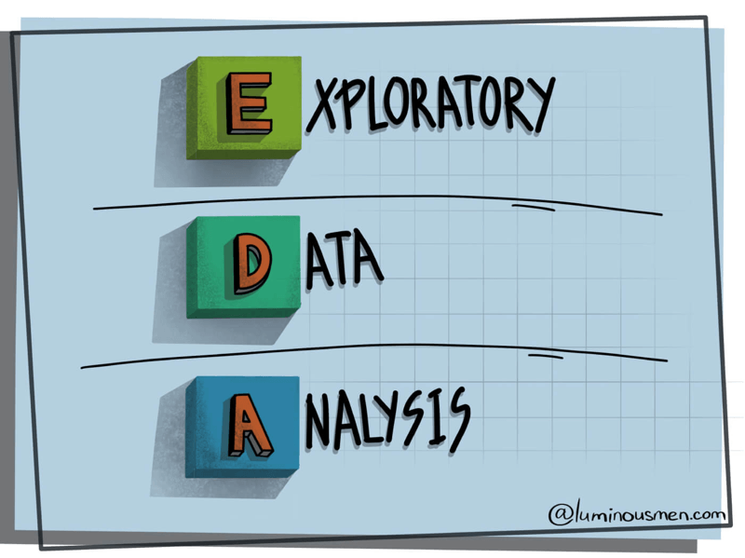
Exploratory Data Analysis
Page 3
What is EDA ?
Exploratory Data Analysis(EDA) is a crucial step in the Data Analysis process that involves examining and understanding the underlying patterns, relationships, and characteristics of your business data. It allows you to gain valuable insights, identify trends, and make informed decisions based on a thorough understanding of your data.
Steps involved in EDA.
Data Understanding
Pattern Identification
Data Cleaning and Preprocessing
Feature Selection
Visualization and Communication

Slide 5

Understanding of datasets used for analysis.
Page 4
Details of Datasets.
Age_Country.csv
Education_Languages.csv
Gender_SatRate.csv
Marriage_Children.csv
Details of Master dataset.
We have merged all four datasets to get as accurate advice as possible for you.
Column name “Satisfaction rate” would be our main column to help you find better way to manage marketing strategy to be more efficient. In our data we have 6 categorical columns which means they contain word values, and 4 numerical columns which contain number values.
Total Number:
87 Rows
10 Columns

Slide 6
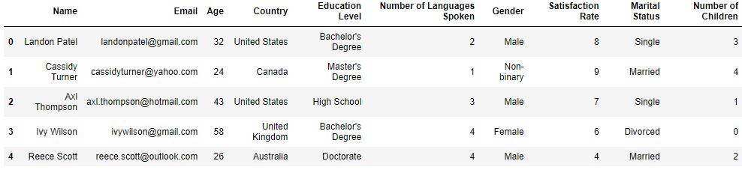
Data Understanding
Page 5
Top 5 rows and columns included in MasterData.
First, we want you to look this table which contain as mentioned in title first 5 rows, but more importantly we can see what columns we will be looking at in this presentation.

Slide 7
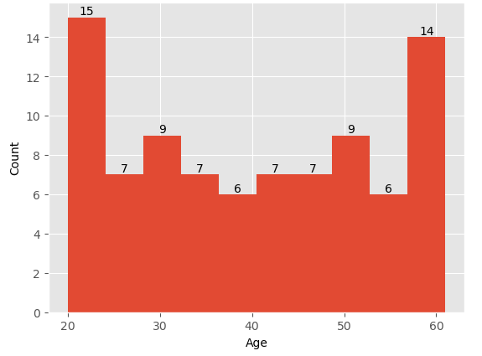
Statistics and Visualization
Page 6
Count of Age pre age group.
Our first part of Statistical and Visualization analysis we present Figure number 1 with the count of each case per age group. The response for your survey was just about even between younger and older population. For age between 20-40 we got 44 respondents, for age between 40-60 the respondents count is 43.
Fig. 1
Part a).

Slide 8
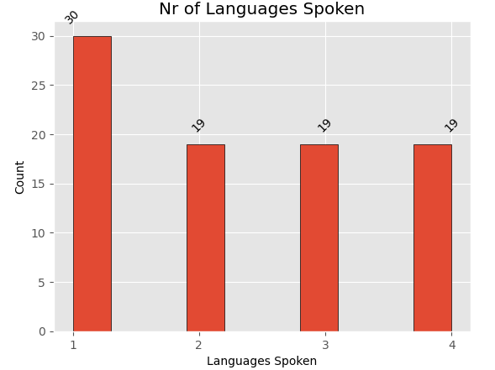
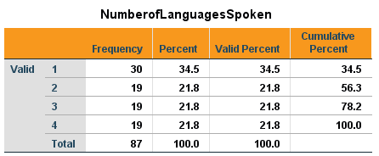
Statistics and Visualization
Page 7
Count of frequency of Languages Spoken.
Next up we present column for count per Nr of Languages Spoken. As we can see on Figure 2, highest count in survey are spoken one language but also, we can indicate that we got evenly match count of people speaking more then 1 language and the number for those cases is 19.
Fig.2

Slide 9
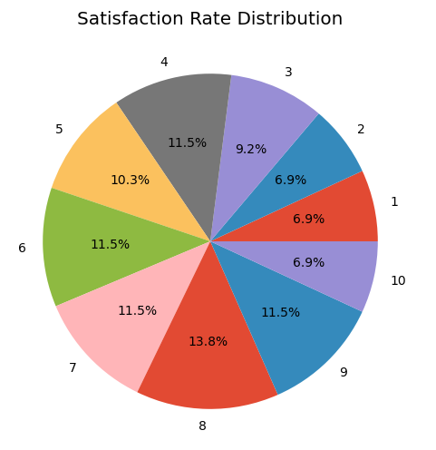
Statistics and Visualization
Page 8
Count of Satisfaction Rate cases.
Our next column target is Satisfaction Rate Distribution. As shown on Figure number 3, the highest count for rate is 8 with 13.8% followed up by 9 with 11.5%. This percentage was equaled by rate 7/6 and 4. Next one is 5, after 3 and last, we have 3 values of 6.9% for rate 10/1/2 of Satisfaction Rate.
Fig.3

Slide 10
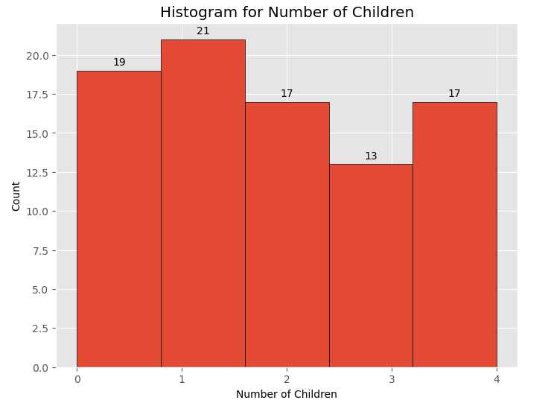
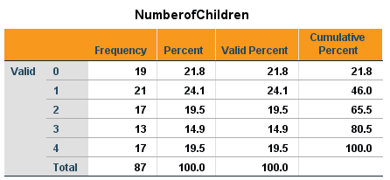
Statistics and Visualization
Page 9
Count of Number of Children frequency.
For our last analysis on Numerical columns, we are looking at Number of Children frequency per each case. Highest count as we can see its for 1 child, after we got 0 kids followed up by 2 children equal with 4 and lastly, we got 3 kids as shown on Figure number 4.
Fig.4

Slide 11
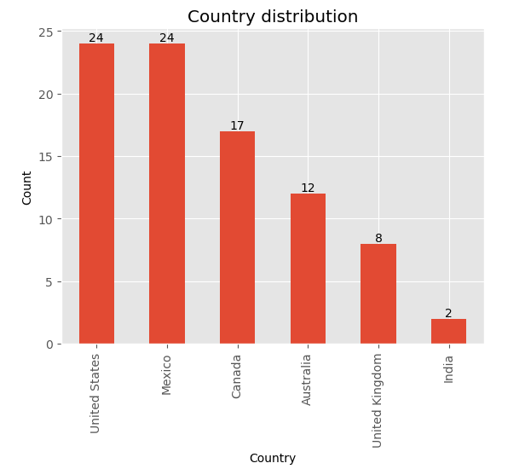
Statistics and Visualization
Page 10
Count of cases per Country.
In this section of the Statistical and Visual Analysis, we move on to next part of our presentation in which we will be looking at categorical columns. We will examine the frequency of cases per Country. As illustrated on Figure 5 the highest count in our survey for each case is in United States and Mexico, followed by Canada, Australia, United Kingdom and India.
Part b).
Fig.5

Slide 12
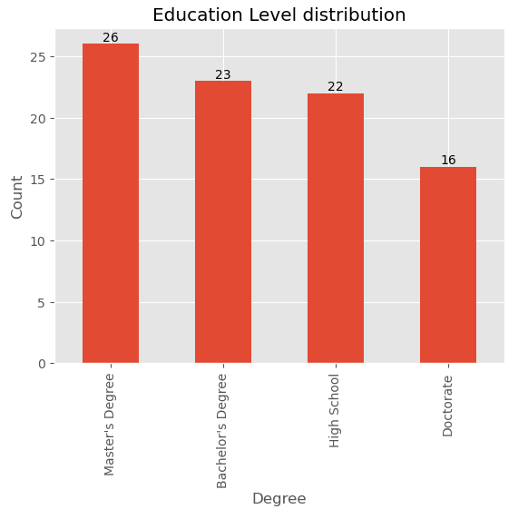
Statistics and Visualization
Page 11
Count per Education Level.
For our second step in part b) of analysis, we got a frequency of each surveyed Education Level. As our chart shows Master’s Degree was the highest with frequency of 26 level of education, next up is Bachelor’s Degree with 23, after very close to last degree we got High School with frequency of 22, and last position for level of education is Doctorate with frequency of 16.
Fig.6

Slide 13
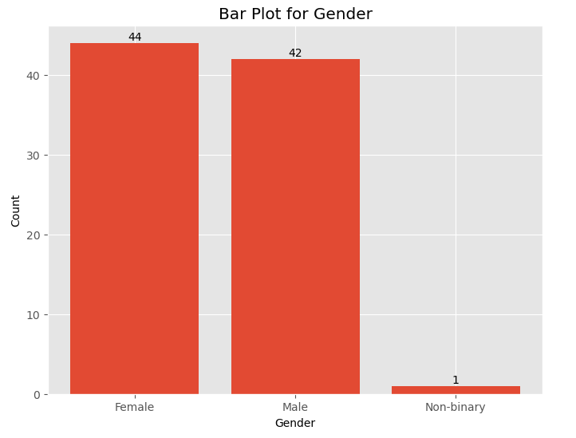
Statistics and Visualization
Page 12
Count per Gender.
As we are approaching slowly to the end of part b) analysis in this presentation and getting last details of single columns in this dataset, our next Figure nr 7 provide us with count of each gender who took survey. The highest frequency of surveyed was Female’s with a score of 44, then we got Male’s with just 2 cases less and last with only 1 case we have Non-binary.
Fig.7

Slide 14
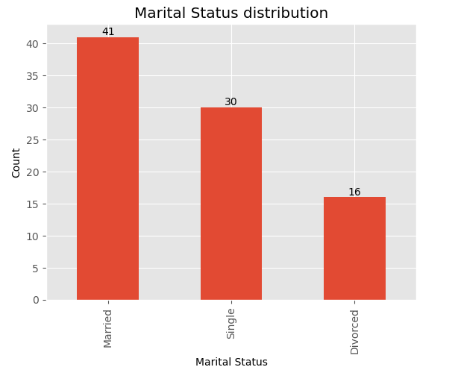
Statistics and Visualization
Page 13
Count per Marital Status.
Here we will be looking at Figure which represents a column Marital Status which is last Figure in part b). Married case with 41 frequency is the highest score in our Figure followed by Single with 30 frequency and last we got Divorced, with a score of 16.
Fig.8

Slide 15

Summary of our Findings.
Page 11
PART 3

Slide 16

Recommendations
Page 12
PART 3

Slide 17
Thank you for your time and attention !

